Slide 1
Propositional Logic, Part 2 Lecture 15 Chapter 7, Sections 7.4
Jim Rehg
College of Computing
Georgia Tech
February 15, 2016

Slide 2
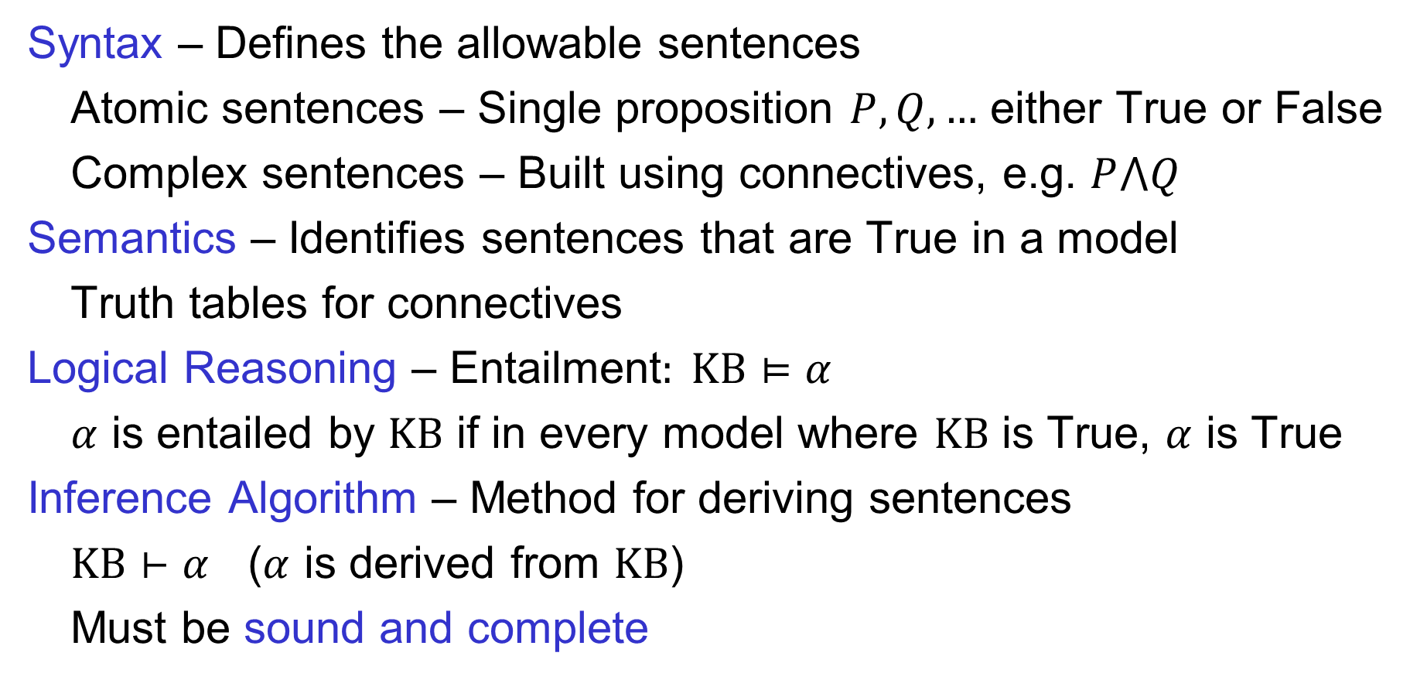
Elements of Propositional Logic
Syntax – Defines the allowable sentences
Atomic sentences – Single proposition $P, Q, …$ either True or False
Complex sentences – Built using connectives, e.g. $P⋀Q$
Semantics – Identifies sentences that are True in a model
Truth tables for connectives
Logical Reasoning – Entailment$: KB⊨α$
$α$ is entailed by $KB$ if in every model where $KB$ is True, $α$ is True
Inference Algorithm – Method for deriving sentences
$KB⊢α$ ($α$ is derived from $KB$)
Must be sound and complete

Slide 3
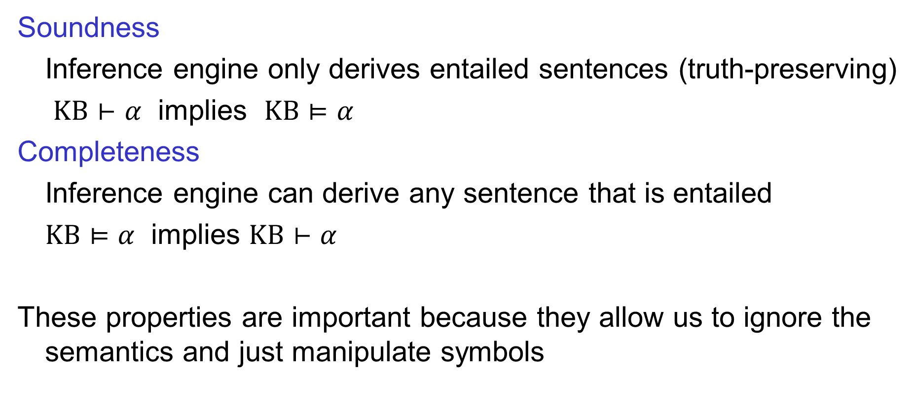
Soundness and Completeness
Soundness
Inference engine only derives entailed sentences (truth-preserving)
$KB⊢α$ implies $KB⊨α$
Completeness
Inference engine can derive any sentence that is entailed
$KB⊨α$ implies $KB⊢α$
These properties are important because they allow us to ignore the semantics and just manipulate symbols

Slide 4
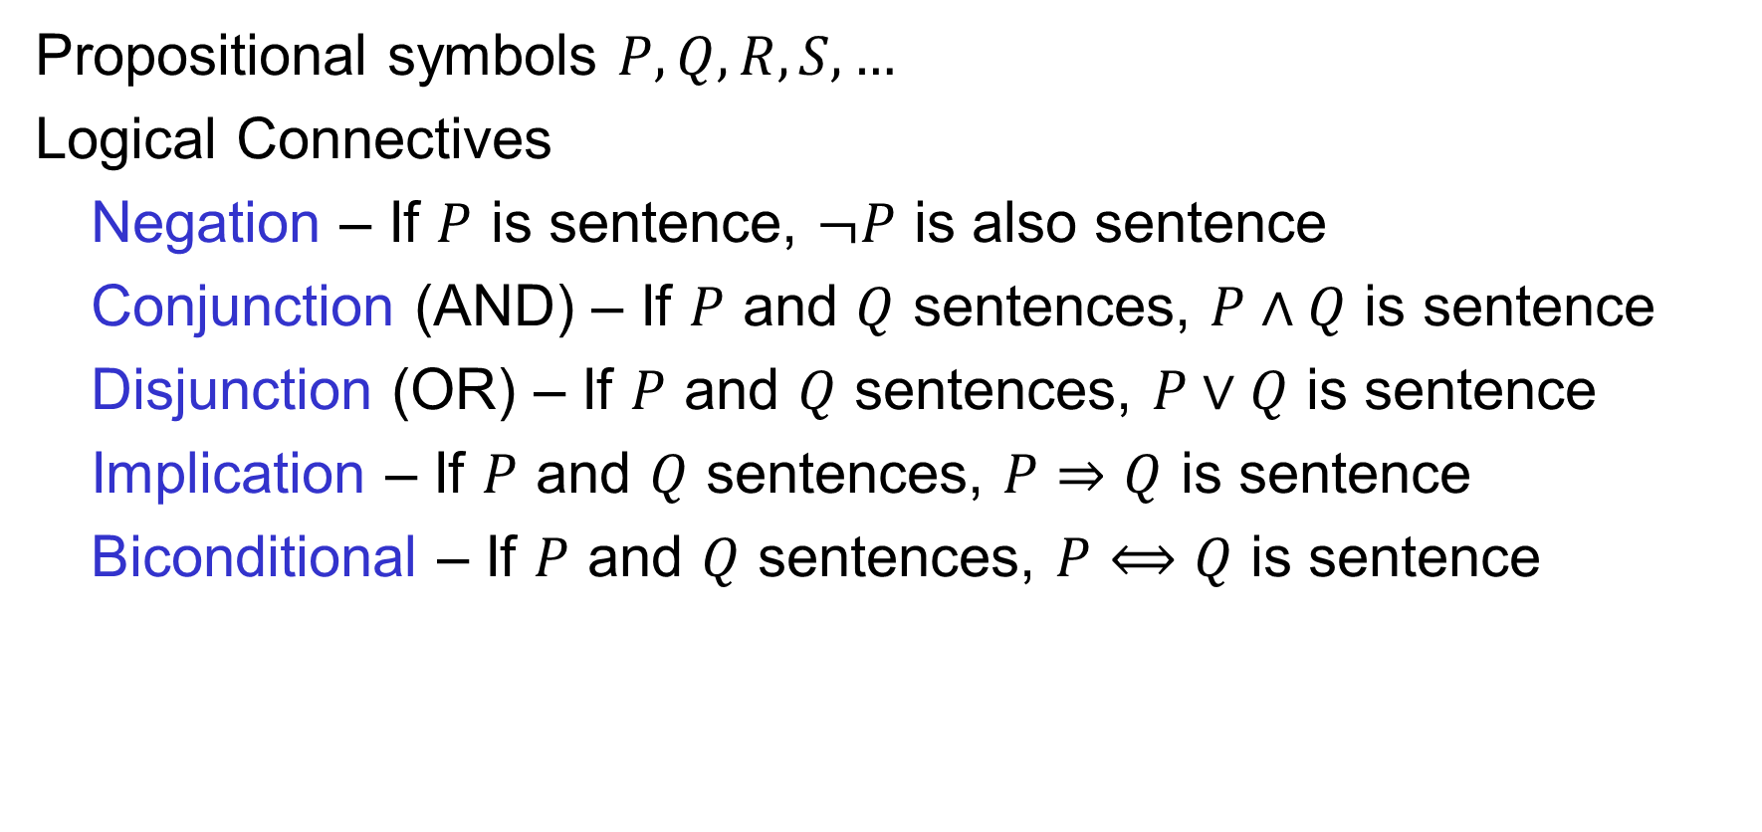
Prepositional Logic: Syntax
Propositional symbols $P, Q, R, S,…$
Logical Connectives
Negation – If $P$ is sentence, $¬P$ is also sentence
Conjunction (AND) – If $P$ and $Q$ sentences, $P∧Q$ is sentence
Disjunction (OR) – If $P$ and $Q$ sentences, $P∨Q$ is sentence
Implication – If $P$ and $Q$ sentences, $P⇒Q$ is sentence
Biconditional – If $P$ and $Q$ sentences, $P⟺Q$ is sentence

Slide 5
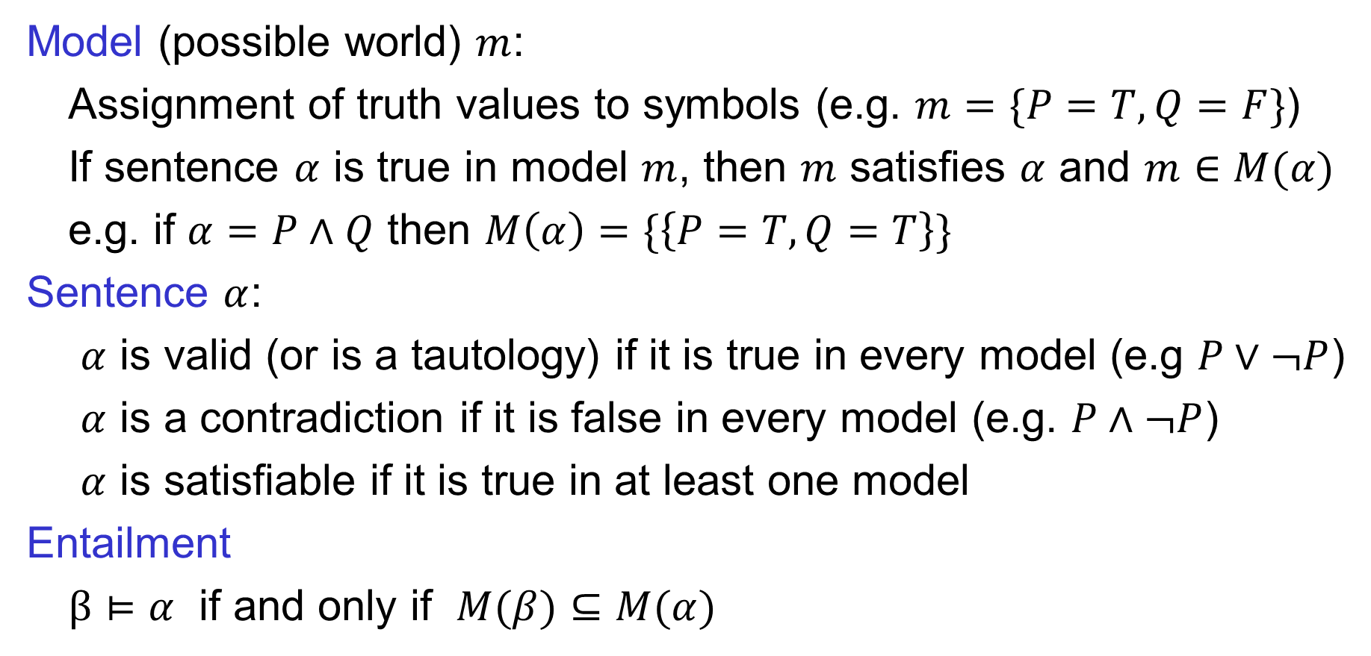
Propositional Logic: Semantics
Model (possible world) $m$:
Assignment of truth values to symbols (e.g. $m=\{P=T, Q=F\}$)
If sentence $α$ is true in model $m$, then $m$ satisfies $α$ and $m∈M(α)$
e.g. if $α=P∧Q$ then $M\left(α\right)=\{\left\{P=T,Q=T\right\}\}$
Sentence $α$:
$α$ is valid (or is a tautology) if it is true in every model (e.g $P∨¬P$)
$α$ is a contradiction if it is false in every model (e.g. $P∧¬P$)
$α$ is satisfiable if it is true in at least one model
Entailment
$β⊨α$ if and only if $M(β)⊆M(α)$

Slide 6
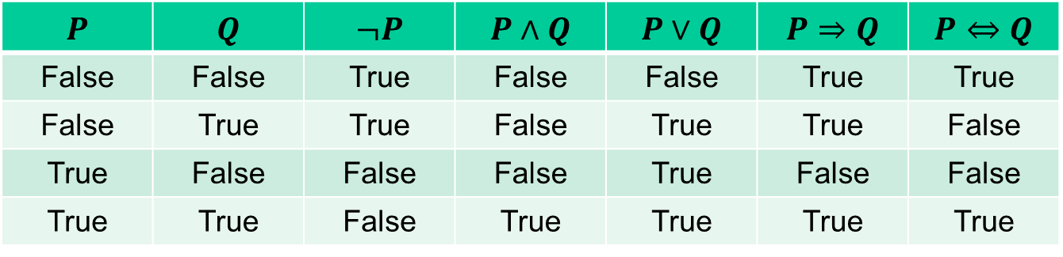
Propositional Logic: Truth Tables
$$P$$ | $$Q$$ | $$¬P$$ | $$P∧Q$$ | $$P∨Q$$ | $$P⇒Q$$ | $$P⇔Q$$
False | False | True | False | False | True | True
False | True | True | False | True | True | False
True | False | False | False | True | False | False
True | True | False | True | True | True | True

Slide 7

Example Knowledge Base (KB)
$$KB=(A∨B)∧(¬C∨A)$$

Slide 8

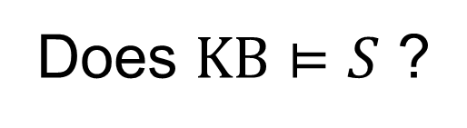

Entailment
$$KB=(A∨B)∧(¬C∨A)$$
$$S=A∧C$$
Does $KB⊨S$ ?

Slide 9


Entailment
$$KB=(A∨B)∧(¬C∨A)$$
$$S=A∨B∨C$$
Does $KB⊨S$ ?

Slide 10
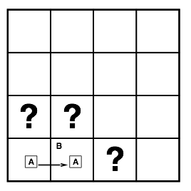
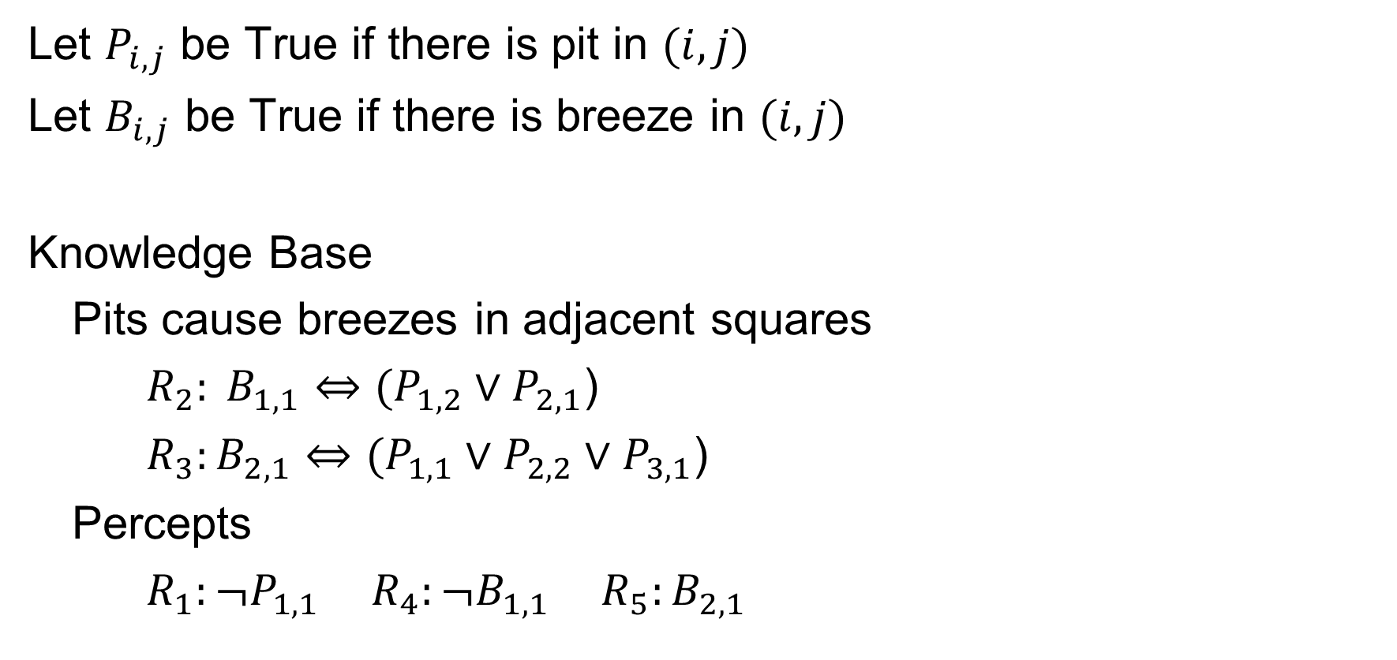
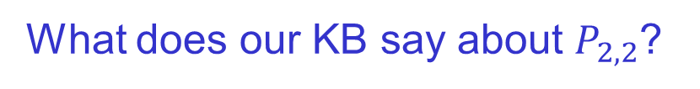
Sentences in Wumpus World
Let $P_{i,j}$ be True if there is pit in $(i,j)$
Let $B_{i,j}$ be True if there is breeze in $(i,j)$
Knowledge Base
Pits cause breezes in adjacent squares
${R_{2}: B}_{1,1}⇔(P_{1,2}∨P_{2,1}$)
${R_{3}:B}_{2,1}⇔(P_{1,1}∨P_{2,2}∨P_{3,1}$)
Percepts
${R_{1}:¬P}_{1,1}$ $R_{4}:{¬B}_{1,1}$ ${R_{5}:B}_{2,1}$
What does our KB say about $P_{2,2}$?

Slide 11
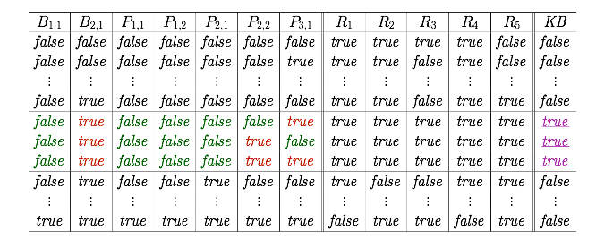
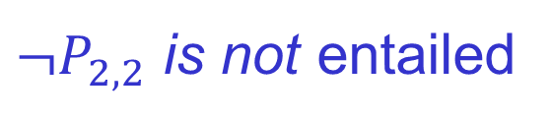
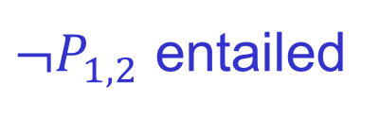
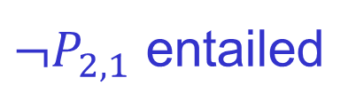
Entailment by Enumeration
Model
KB Sentences
${¬P}_{1,2}$ entailed
${¬P}_{2,1}$ entailed
${¬P}_{2,2}$ is not entailed

Slide 12
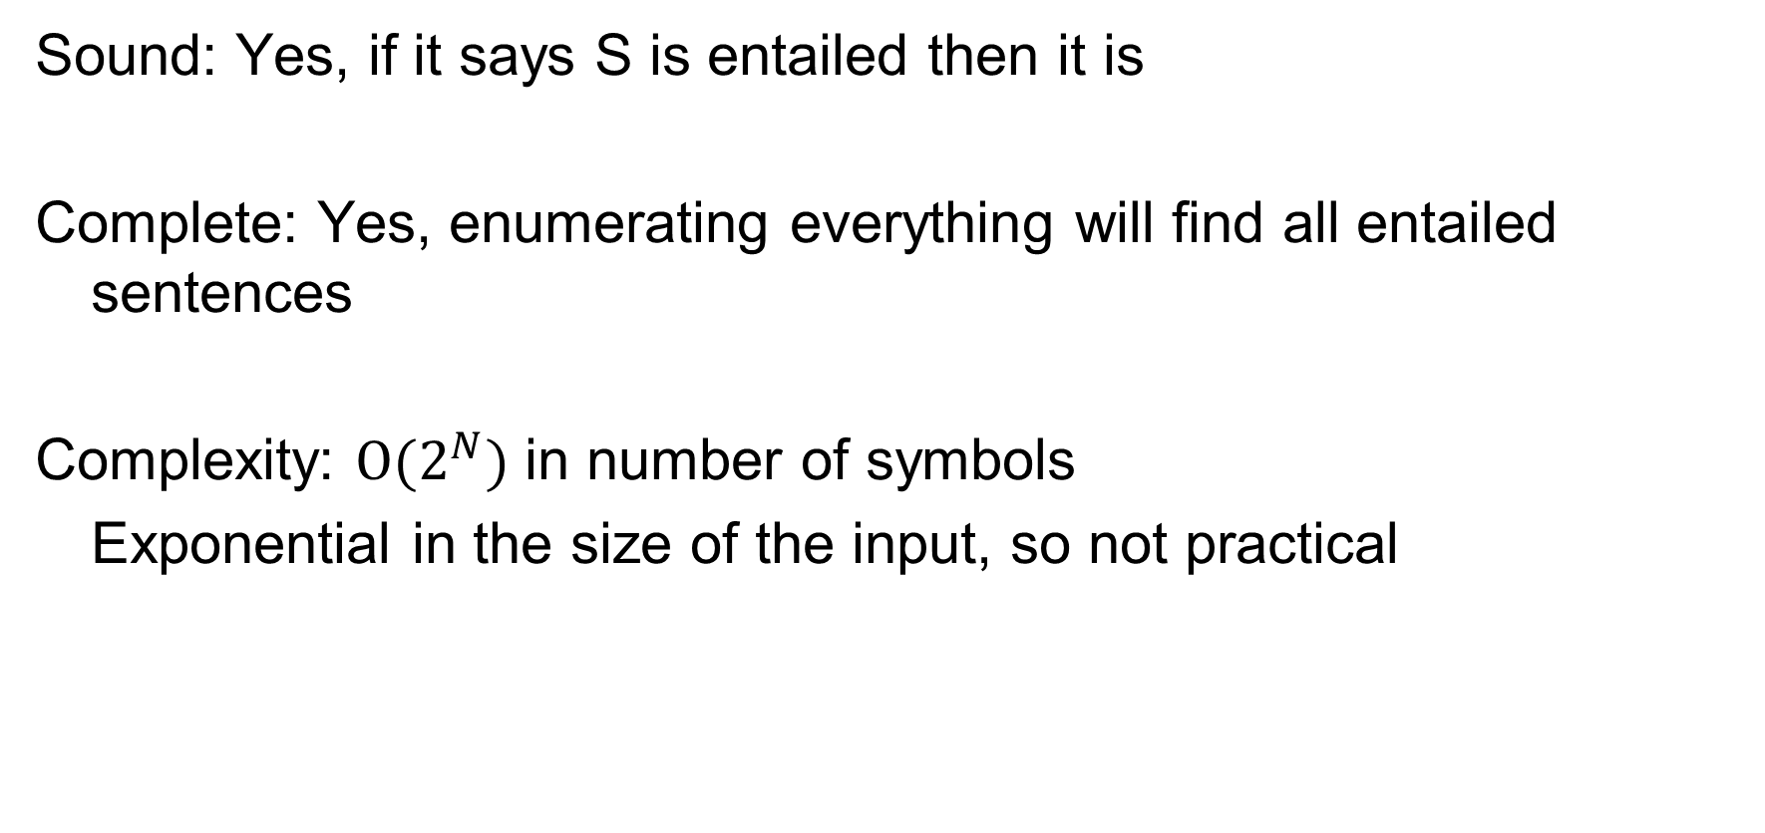
Entailment by Enumeration
Sound: Yes, if it says S is entailed then it is
Complete: Yes, enumerating everything will find all entailed sentences
Complexity: $O(2^{N})$ in number of symbols
Exponential in the size of the input, so not practical

Slide 13
Another Example: Autonomous Car

Slide 14
Model Checking

Slide 15
Questions?

